Slide 1
GOLD-COPPER\MOLYBDENUM PORPHYRY DEPOSIT
Porphyritic fields – are among the main sources of Cu, Mo and also Ag, Au, Sn at the accompanying Re, W, In, Pt, Pd, and Se.
From 50 to 60% of world production of copper and more than 95% of world production of Mo fall to their share.
Spatially and genetically they are connected with sour or average intrusions of porphyries.
They differ from other fields of a granitoid row in the sizes and a structural position (a zone of crushing, a brekchirovaniye and small jointing).
Copper and porphyritic fields are characterized by a shtokverkovy shape of ore bodies, mainly large sizes, low contents and rather uniform spatial distribution of copper, availability of the extracted valuable passing impurity (molybdenum, rhenium, gold, silver).

Slide 2
GOLD-COPPER\MOLYBDENUM PORPHYRY DEPOSIT
Existence of zones of secondary sulphidic enrichment in which the content of copper increases by 1.5–3 times in comparison with primary ores is characteristic of them.
There is a broad variety of copper and porphyritic fields and, thus, each field needs to be considered as a concrete, special case.
At the same time there are many characteristics which are typical for copper and porphyritic systems that has led to a set of generalizations and creation of empirical models.

Slide 3
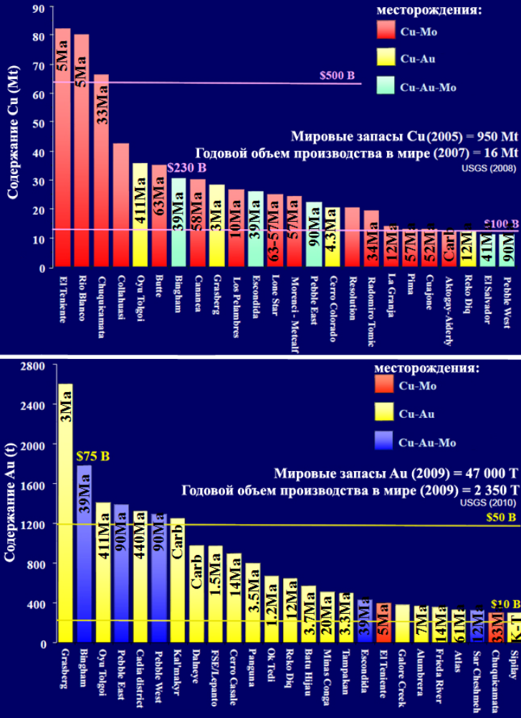
GOLD-COPPER\MOLYBDENUM PORPHYRY DEPOSIT

Slide 4
GOLD-COPPER\MOLYBDENUM PORPHYRY DEPOSIT

Slide 5
GOLD-COPPER\MOLYBDENUM PORPHYRY DEPOSIT
Spatial arrangement and age
The analysis of spatial placement copper molybdenum - porphyritic fields of the world unambiguously confirms their confinedness to regional belts of a skladchatost - to mobile belts: Pacific, Mediterranean, Uralo-Mongolsky and to some other.
The majority of fields of Cu-porphyritic type is located within three planetary the metallogenicheskikh of belts – Pacific, Mediterranean and Asian and Kazakhstan-Mongolian where also copper-ore objects of other industrial genetic types concentrate.
Porphyritic fields are formed in the volcanic arches connected with a subduktion. Within belts of a skladchatost of the field are drawn towards zones of manifestation of magmatism (vulkanoplutonichesky belts).
The age of porphyritic fields - from archaean to, almost, modern, but the majority of economically attractive objects is younger than Yura

Slide 6
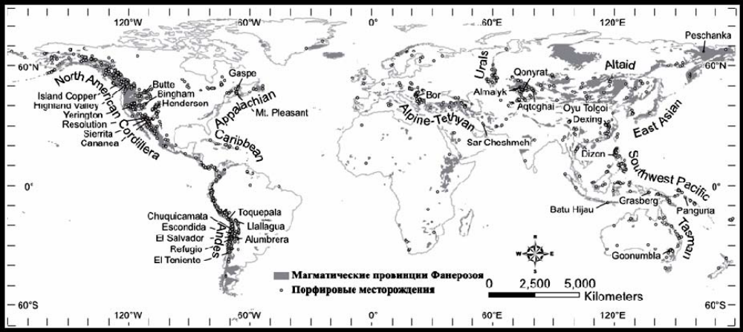
GOLD-COPPER\MOLYBDENUM PORPHYRY DEPOSIT
The global distribution of porphyritic fields showing distribution the fanerozoyskikh of magmatic provinces, separate porphyritic knots and porphyritic belts on Seedorff

Slide 7
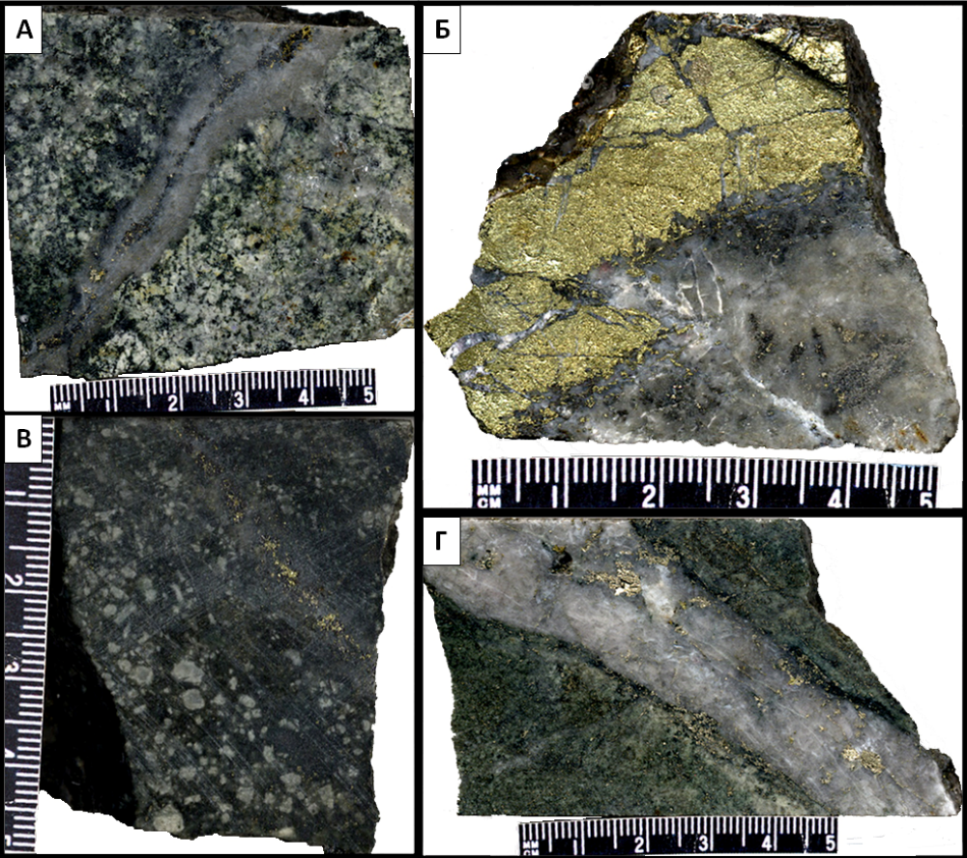
GOLD-COPPER\MOLYBDENUM PORPHYRY DEPOSIT
Lithology
Cu-Mo-Au-porphyritic fields are accompanied by porphyritic rods with a diameter from 100 m to several kilometers. In honey-but-porphyritic systems, several phases of introduction of intrusions, the earliest of which, most often, contain the most concentrated ores, are usually observed. In a number of fields the containing breeds also contain ores though intrusions contain on average about 70% of porphyritic ores of the field.
Cu-Fe-sulphidic ore minerals settle down in quartz the shtokverkovykh veins and in the form of scattered ores (Fig. 3B) which associate with an early stage of the "potassium" secondary changes presented by biotite, magnetite and changeable KPSh

Slide 8
GOLD-COPPER\MOLYBDENUM PORPHYRY DEPOSIT
Alteration
Hydrothermal changes are formed by Argillitovye on removal from veins with seritsitovy auras; but kaolinite also smektit can be followed by sericite and chlorite. Mineral complexes hypogene "expanded the argillitovykh" changes, are put by quartz, kaolinite, pyrophyllite, to diasporas, alumstone and sometimes andalusite.
Secondary changes are presented to Propilitovye epidoty, chlorite and calcite, are formed in the form of a wide aura, radius in several kilometers. They gradually in process of removal pass in invariable or regionally the changed containing breeds

Slide 9
GOLD-COPPER\MOLYBDENUM PORPHYRY DEPOSIT
Metallogenic zoning
Copper and molybdenum - porphyritic fields spatially are accompanied by an industrial mineralization of other genetic types, especially kolchedanny, gold, copper and polymetallic and quartz - sulphidic. On copper and molybdenum - porphyritic ores is quite often imposed later poorly sulphidic mineralization. The last, concentrating on some removal, forms own fields of vein type. Thus, the metallogenichesky zonality in placement of ore fields is noted. The revealed regularities should be considered when forecasting gold-bearing copper and porphyritic and copper molybdenum - porphyritic fields
Also the characteristic uniting these fields, to a dress c their connection with development of the porphyritic magmatism which is implemented in formation shtoko-and the daykoobraznykh of intruziv is the constant combination in ores of copper and molybdenum. The relation of these elements on certain fields varies in the wide range.

Slide 10
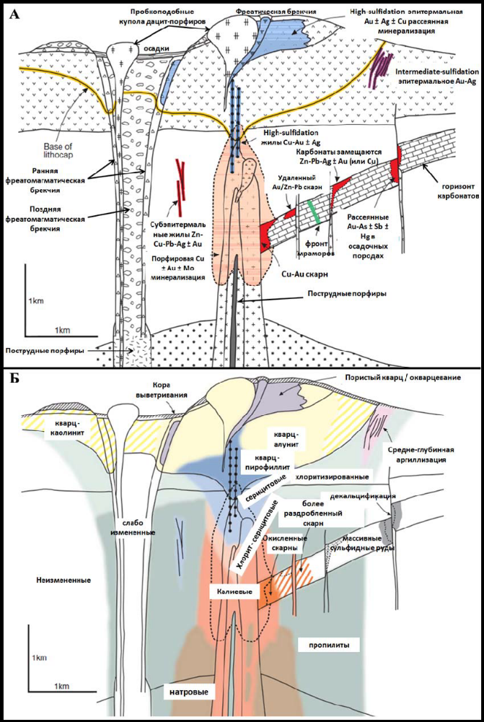
GOLD-COPPER\MOLYBDENUM PORPHYRY DEPOSIT
Metallogenic zoning

Slide 11
GOLD-COPPER\MOLYBDENUM PORPHYRY DEPOSIT
Metallogenic zoning
The correlation of Cu/Mo with type of ore-bearing porphyritic magmatism is usually noted (on kremnezemistosti the porphyritic educations dominating on the field). On this basis various types of fields are often allocated: Cu-popfipovy and Cu(Au) - porphyritic, Mo-Cu-поpфиpовый, Cu-Mo-поpфиpовый, Mo-porfirovy for which the corresponding models have been offered: dioritovy, granodioritovaya, montsonitovy and granitovy. In these models mineralization contacts magmatism of limy, alcali-calcic, izvestkovo-alkaline and subalkaline series.
For search geology the most acceptable is the option of definition of copper and porphyritic type of fields according to which copper manifestation can be referred to copper porphyritic type if for him the following signs are revealed.

Slide 12
GOLD-COPPER\MOLYBDENUM PORPHYRY DEPOSIT
Metallogenic zoning

Slide 13
GOLD-COPPER\MOLYBDENUM PORPHYRY DEPOSIT
Признаки
Formation of copper and porphyritic fields happens in different stages of development of folded areas: as to the main phases of a skladchatost, in connection with initial magmatism (at a stage of island arches), and later, in connection with formation of suburban and continental vulkano-plutonic belts.
Confinedness of fields in vulkano-plutonic belts to volcanic, vulkano-plutonic and volcano-tectonic structures of often ring and izometrichny form.
Prozhilkovo-vkraplenny, shtokverkovy character of a mineralization.
Spatial communication of mineralization with porphyritic intrusions of mainly average structure: dioritovy porfirita; sour: granodiorit-, granite-porphyries, quartz porphyries and more alkaline: quartz montsonit-porphyries.
Confinedness of a mineralization or directly to porphyritic intrusions, or to the containing breeds nearby the ekzokontaktovykh of zones.
Manifestation diatry and explosive brekchiya; boiling up of solutions.

Slide 14
GOLD-COPPER\MOLYBDENUM PORPHYRY DEPOSIT
Character
Development of mineralization in zones of widely shown hydrothermal changes (potassium, phyllitic, the argillizitovykh and the propilitovykh), temperatures, characteristic of wide range; zonality of secondary minerals (from the center of system to the periphery): biotite, potassium feldspar → sericite, quartz → montmorillonite, kaolinite → chlorite, calcite, эпидот and other.
The increased oxidizing potential and high salinity of ore-forming fluids.
Steady composition of the main ore minerals (pyrite, magnetite, chalcopyrite, in a number of fields - bornite, molybdenite, enargite, chalcosine) and accompanying them nonmetallic (quartz, sericite, potassium feldspar, biotite, minerals of group of a kaolin, etc.).
The sustained geochemical zonality of mineralization of Mo (Cu) - Cu(Mo) - Cu(Au) - Zn, Pb - (Au, Ag).
Emergence of rich ores (Cu = up to 1-1,5%), in connection with processes of oxidation with formation of the zones of secondary sulphidic enrichment blocking poorer primary ores (Cu = 0,2-0,8%). Content of molybdenum in Mo-and Cu-Mo-porphyritic fields can be from 0,07% to 0,3%. In Au-and Cu-Au-porphyritic fields, the content of gold is from 0,2 to 2 g/t.

